Slide 1
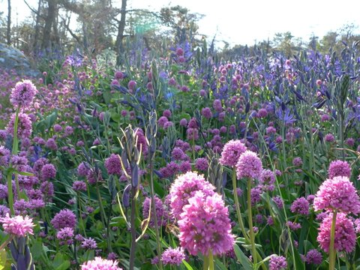

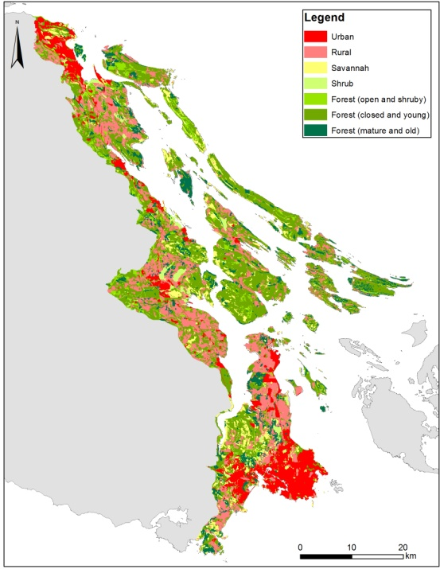
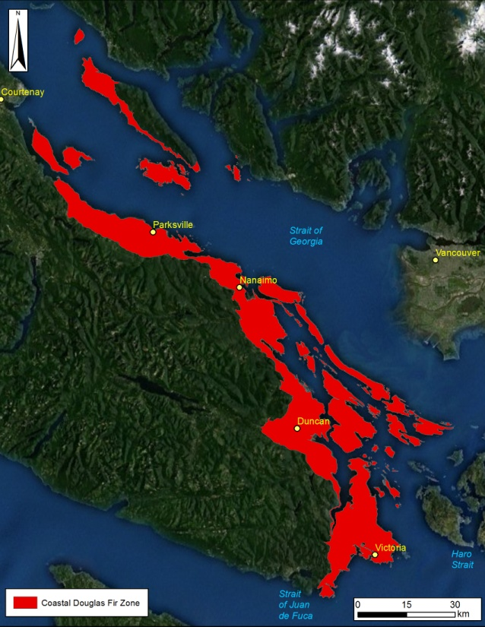
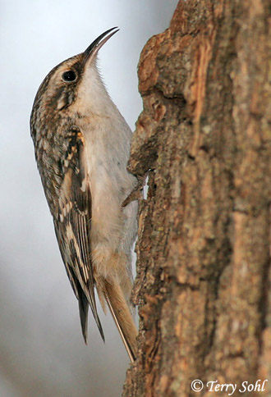
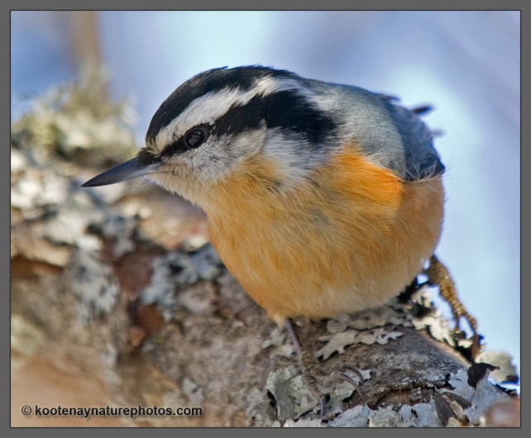
Spatial Prioritization Exercise
Richard Schuster
Liber Ero Fellow
Geomatics and Landscape Ecology Lab
Carleton University

Slide 2
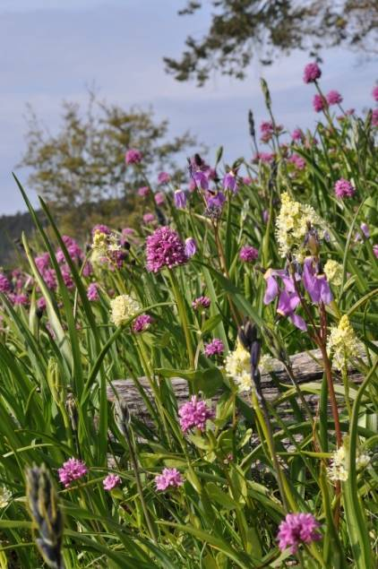
Conservation Area Design
Inform conservation decision-making
Identify good + efficient actions in space + time
Optimize allocation of finite resources
Moilanen et al. (2009)

Slide 3
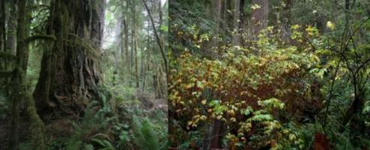
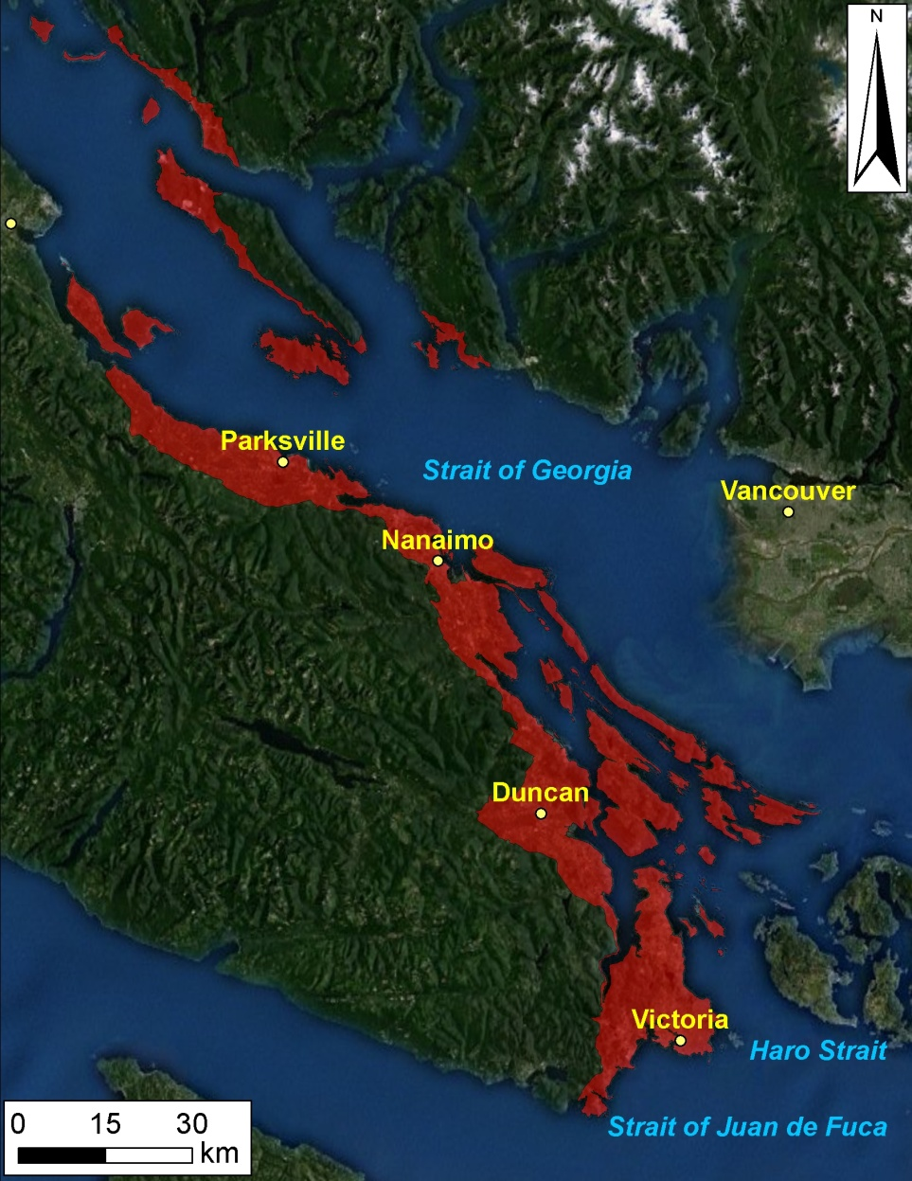
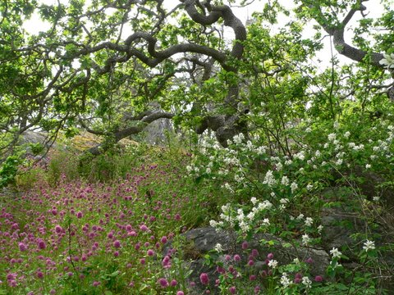
Coastal Douglas Fir Biogeoclimatic zone
Most Imperilled Ecosystem in BC
>60% Converted to Human Use
~84% Private Land
115 ‘Species At Risk’
Study area: ~2500 km²
Austin et al. (2008); Madrone Env. Services (2008)

Slide 4
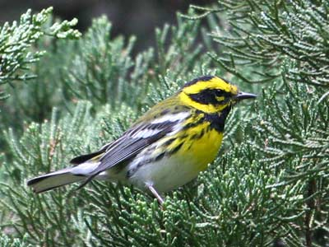
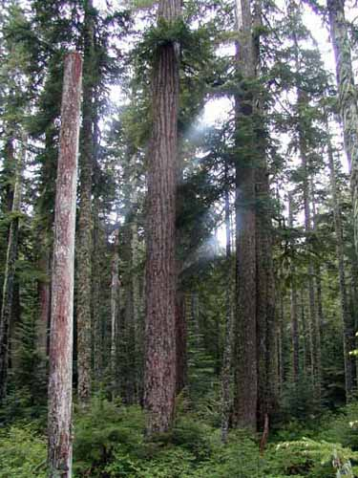

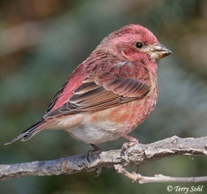
Use Indicator Species to Identify Areas that Support Historically Representative Communities
Specifically
Native bird and plant communities
Insulated from Negative Human Impacts

Slide 5
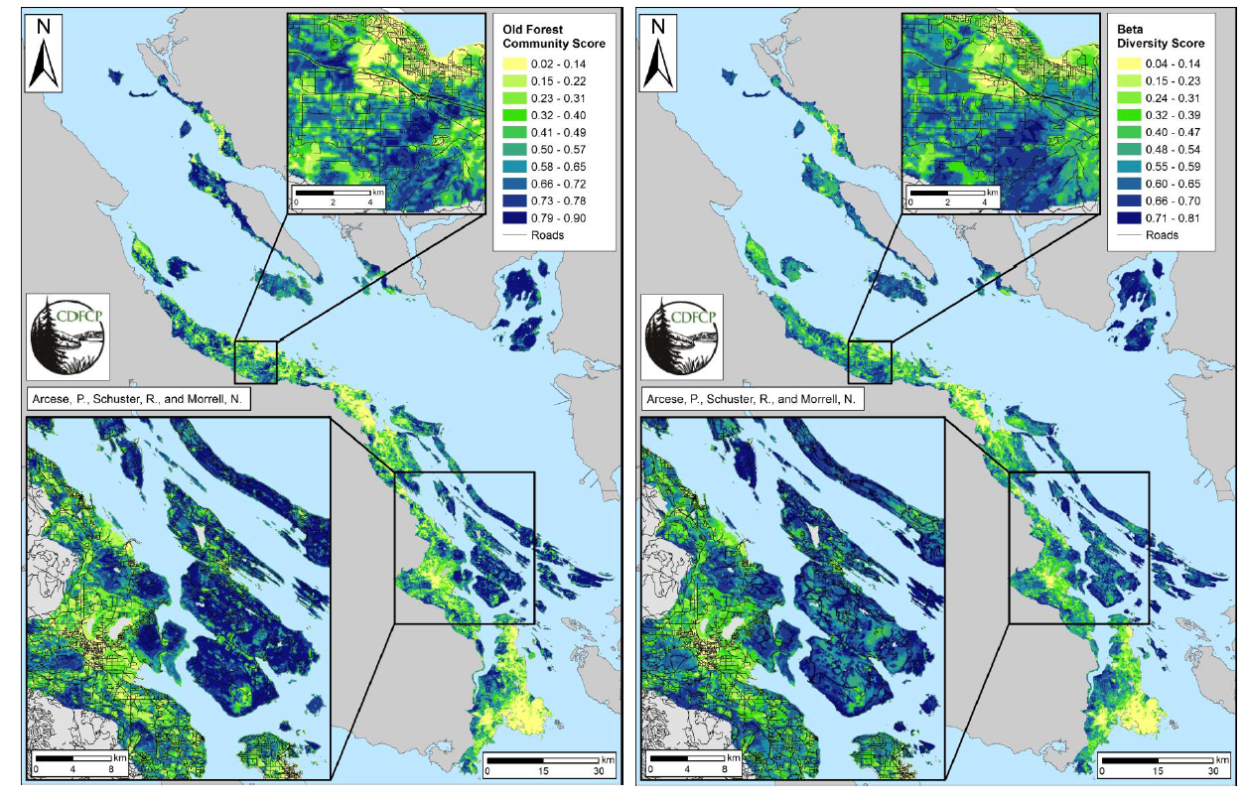
Old forest community Beta diversity

Slide 6
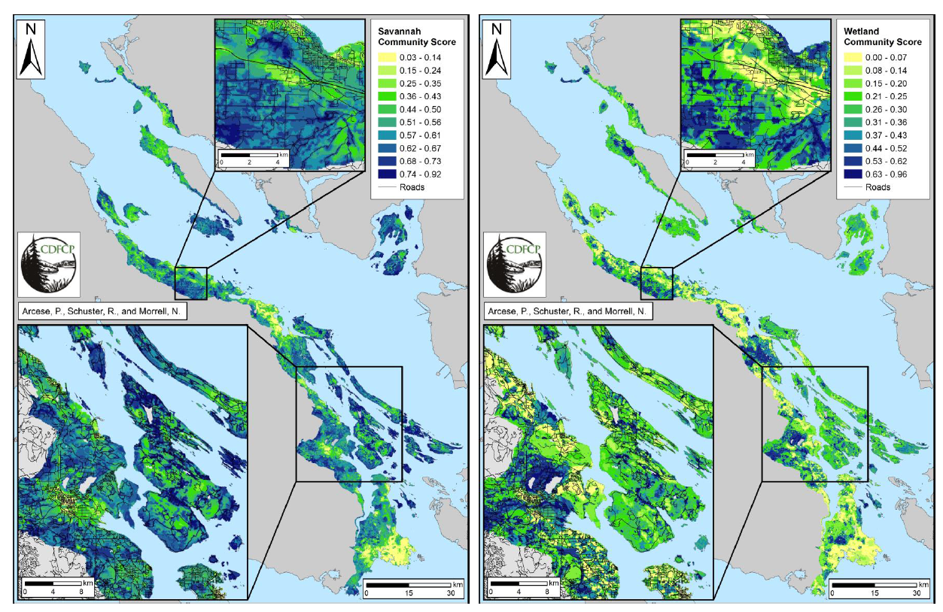
Savannah community Wetland community

Slide 7
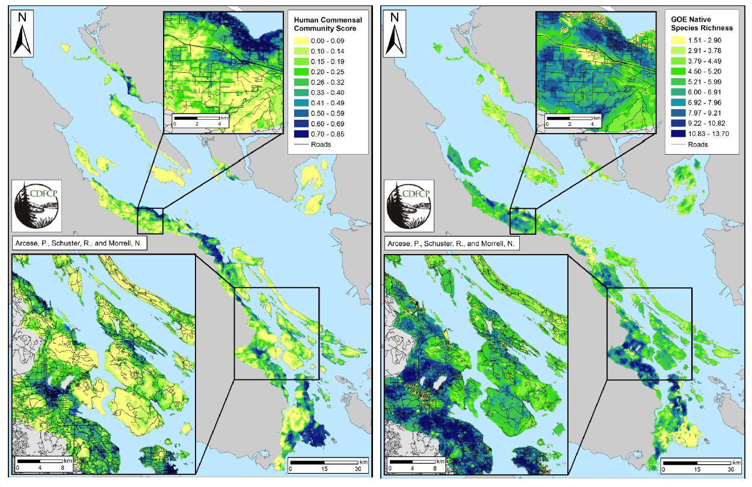
Human commensal community Native plant species richness

Slide 8
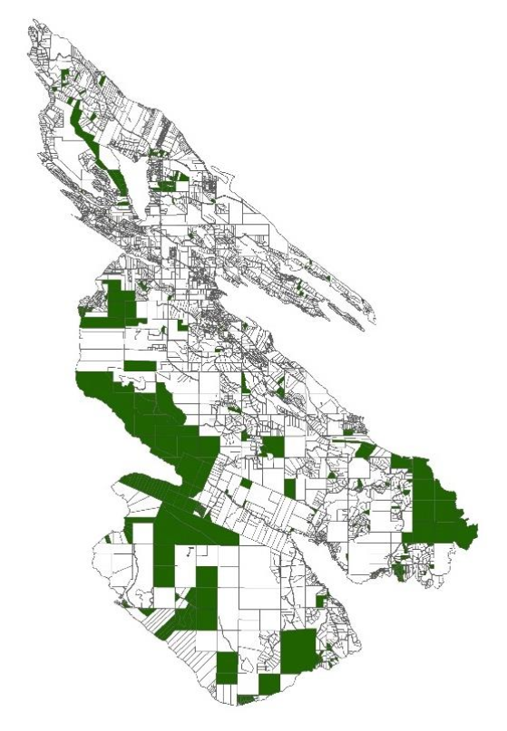
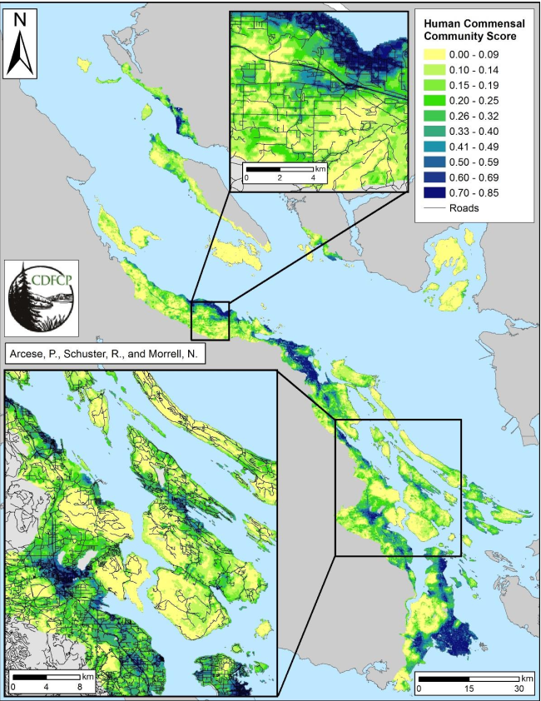
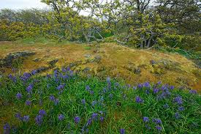
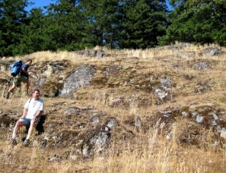
‘Cost’ Layers
Tax Assessed Value
Human-commensal Cost (birds)
Area Cost
Fraction of Planning Area Conserved

Slide 9
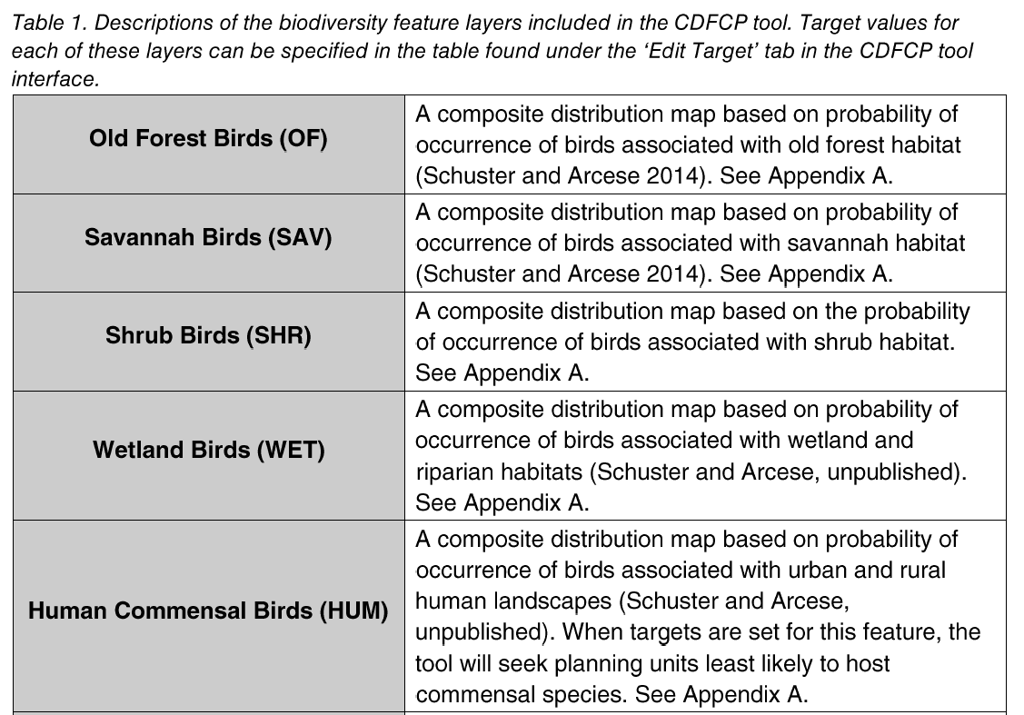
CDFCP tool tutorial (p.15+)

Slide 10
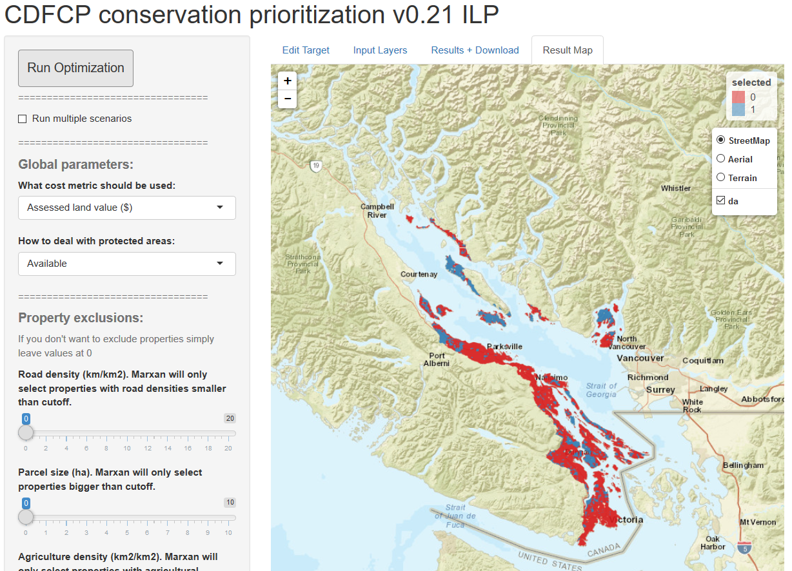

Slide 11
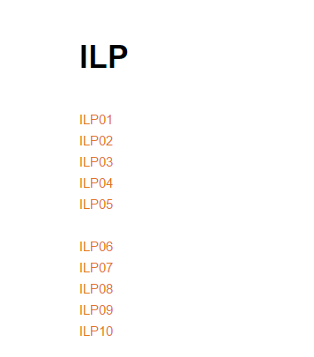
Exercise
http://www.richard-schuster.com/ILP/
10 groups

Slide 12
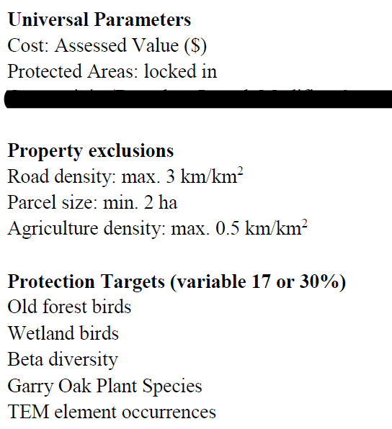
Exercise settings

